Slide 1
Cellular Automata Wars
Ionut Arhire
Coordonator: Drd. Florin Olariu
Notes:
What is a Cellular Automata?
A cellular automaton consists of a regular grid of cells, each in one of a finite number of states, such as ‘alive’ and ‘dead’ in the case of CA Wars. The grid can be in any finite number of dimensions. For my app, the grid is 2-dimensional and so supports only 2-dimensional CAs. For each cell, a set of cells called its neighborhood is defined relative to the specified cell.

Slide 2
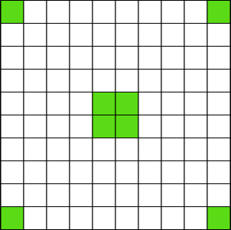

Slide 3
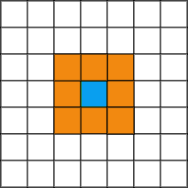

Slide 4
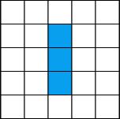
Game of Life transitions
Any live cell with fewer than two live neighbours dies, as if caused by underpopulation.
Any live cell with two or three live neighbours lives on to the next generation.
Any live cell with more than three live neighbours dies, as if by overpopulation.
Any dead cell with exactly three live neighbours becomes a live cell, as if by reproduction.

Slide 5
Glider

Slide 6
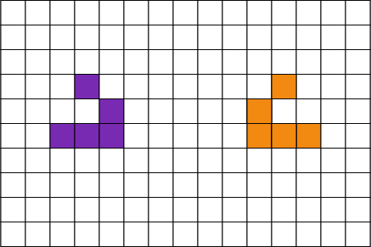
How do we deal with competitive evolution?

Slide 7
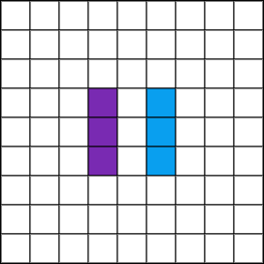
Basic conflict

Slide 8
The S/B Notation
(“Survival”/”Birth”)
Game of Life
23/3
Coral
45678/3

Slide 9
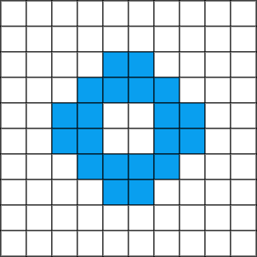
Let’s see how both rules evolve given the same initial configuration

Slide 10
GOF
(“Chaotic” Pattern)
Coral
(“Explosive” Pattern)
Notes:
Coral: This rule produces patterns with a surprisingly slow rate of expansion and an interesting coral-like texture.

